Slide 1

SpecInfer: Accelerating Large Language Model Serving with Tree-based Speculative Inference and Verification
Xupeng Miao, Gabriele Oliaro, Zhihao Zhang, Xinhao Cheng, Zeyu Wang, Zhengxin Zhang, Rae Ying Yee Wong, Alan Zhu, Lijie Yang, Xiaoxiang Shi, Chunan Shi, Zhuoming Chen, Daiyaan Arfeen, Reyna Abhyankar, Zhihao Jia
Presented by Nikhil Kanamarla, Yikang Yue and Michael Wang

Slide 2
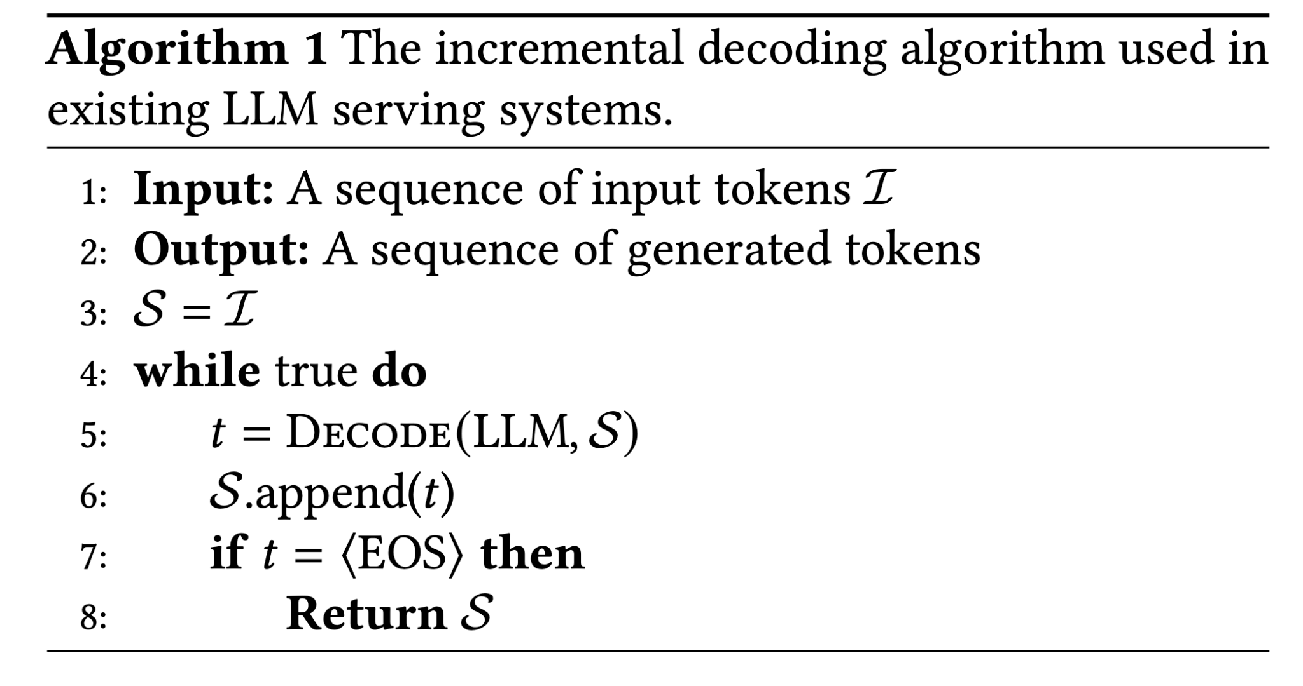
Background
Traditional LLM inference uses a prefill stage for the KV cache done on all tokens in one pass and then uses incremental decoding where one new token is generated for each model pass.
This approach is sequential and therefore slow and memory-intensive.

Slide 3
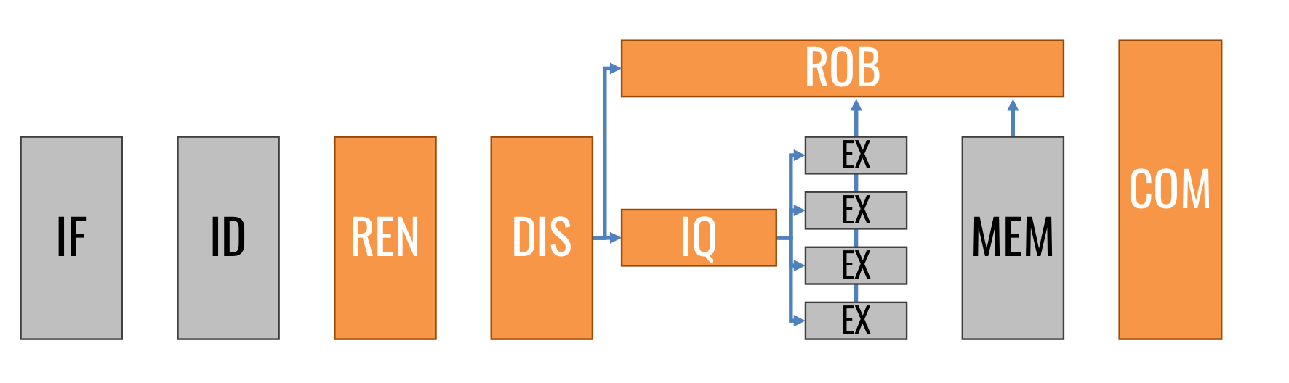
Motivation
Modern processors use speculative execution to improve throughput:
Recent work has introduced speculative inference in LLMs where a smaller model predicts a sequence of tokens and a LLM checks its correctness.
Credit: CS 433
Notes:
In processor optimization, speculative execution is used to improve efficiency by predicting possible outcomes through various forms reordering and prediction. Inspired by this, recent work has introduced sequence-based speculative inference in LLMs, where a smaller model predicts a sequence of tokens, and an LLM checks its correctness in parallel.

Slide 4
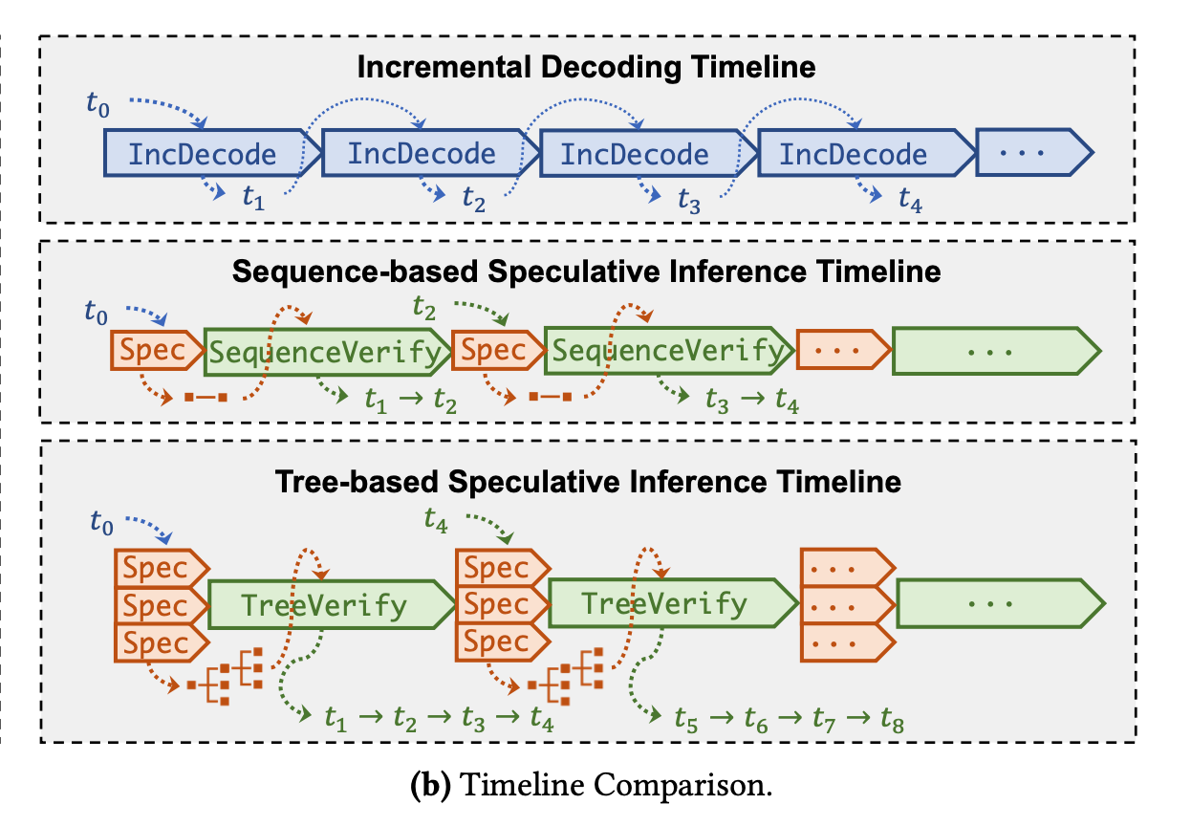
High level approach
Speculative inference with token verification to accelerate LLMs by leveraging tree-based structures.
Small Speculative Models (SSMs) create token trees representing potential sequences.
LLM serves as a verifier to check predictions in bulk.
Notes:
In the current system approaches, we have (1) the traditional incremental decoding, (2) sequence-based speculative inference, and (3) SpecInfer’s tree-based approach.
SpecInfer builds on this speculative idea but takes it a step further. It uses multiple speculative candidates, organized as a token tree, allowing for significantly better performance and parallelism to optimize LLM serving. These smaller models can be 100-1000X smaller than the LLM.
As shown in the timeline comparison, SpecInfer’s token tree structure allows it to check multiple speculative candidates in parallel instead of checking a single sequence step-by-step. This tree-based structure significantly increases the number of tokens that can be verified in a single LLM decoding step.

Slide 5
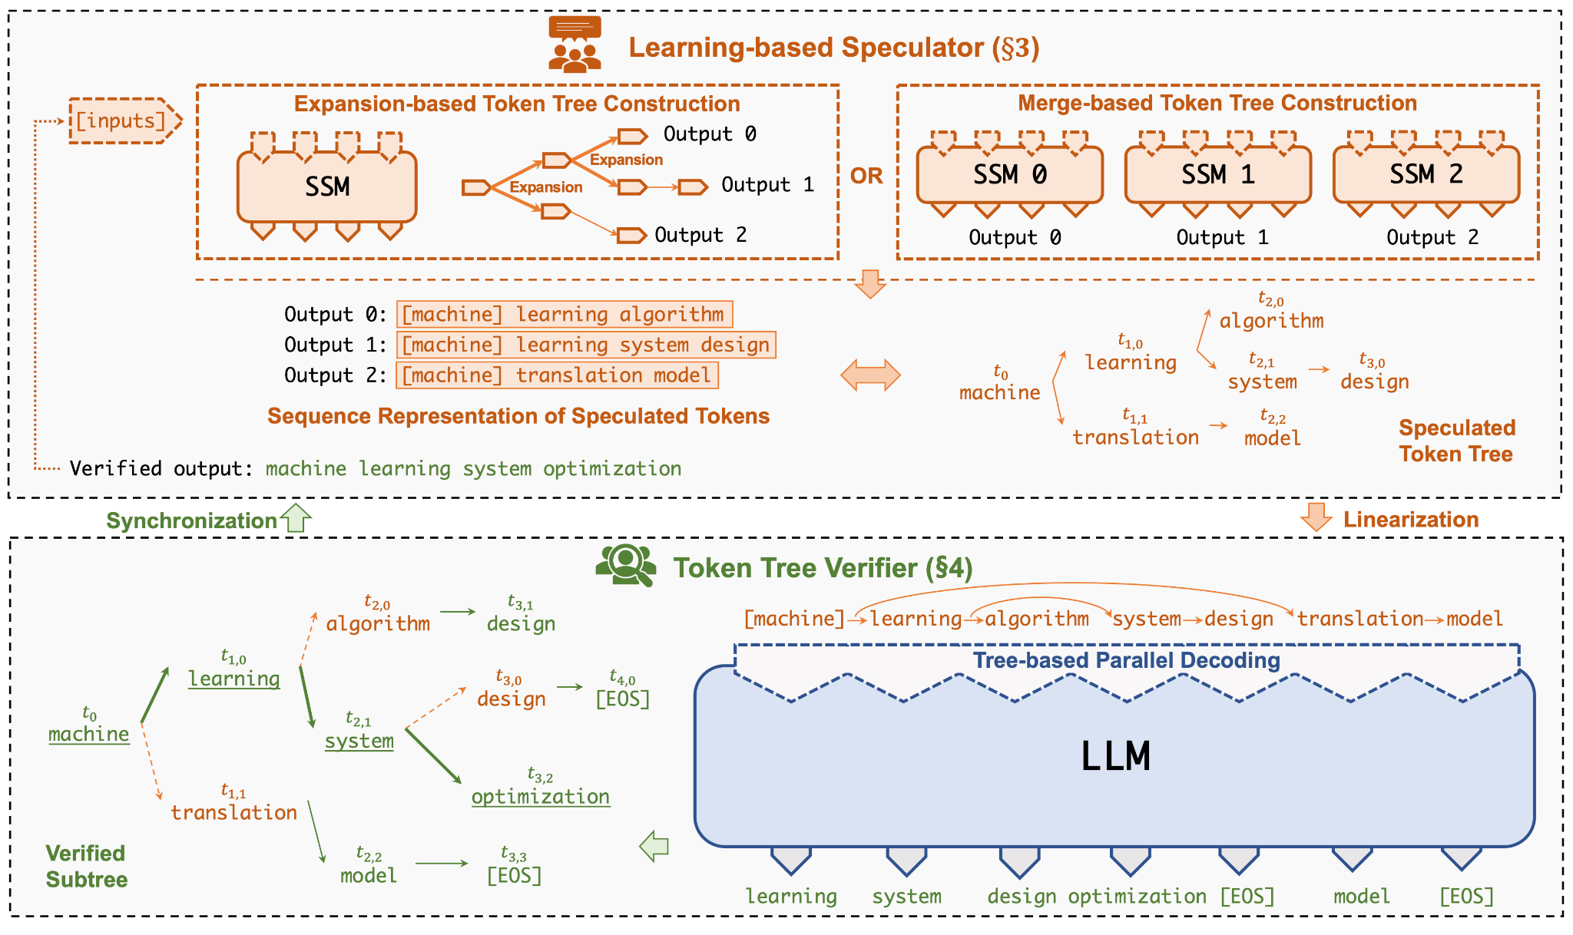
High level approach part 2
The LLM verifies tokens in parallel and uses the MSS algorithm to ensure verified tokens mirror LLM generated tokens.
Notes:
First, let’s discuss the token tree structure. SpecInfer uses what it calls small speculative models (SSMs) to create these token trees, allowing multiple speculative candidates in one structure. This token tree organizes tokens in a branching format, representing potential paths of generated sequences.
There are two methods for constructing these token trees: expansion-based, where tokens are derived from a single SSM, and merge-based, where predictions from multiple SSMs are combined. Both approaches provide the structure needed for tree-based verification.
Second, SpecInfer’s tree-based parallel decoding mechanism allows it to verify all tokens in a tree simultaneously.
Finally, SpecInfer uses a multi-step speculative sampling (MSS) algorithm to ensure verified tokens closely align with those generated by the LLM using stochastic sampling. This MSS approach improves the verification process over naive sampling methods.

Slide 6
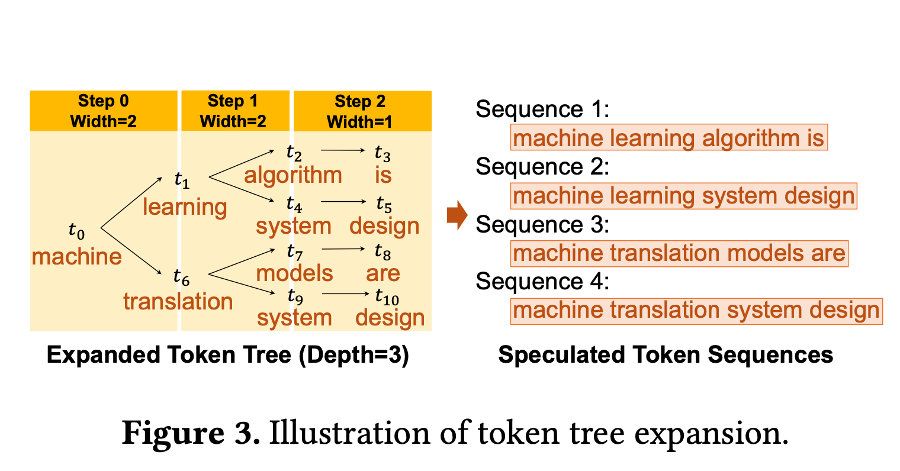
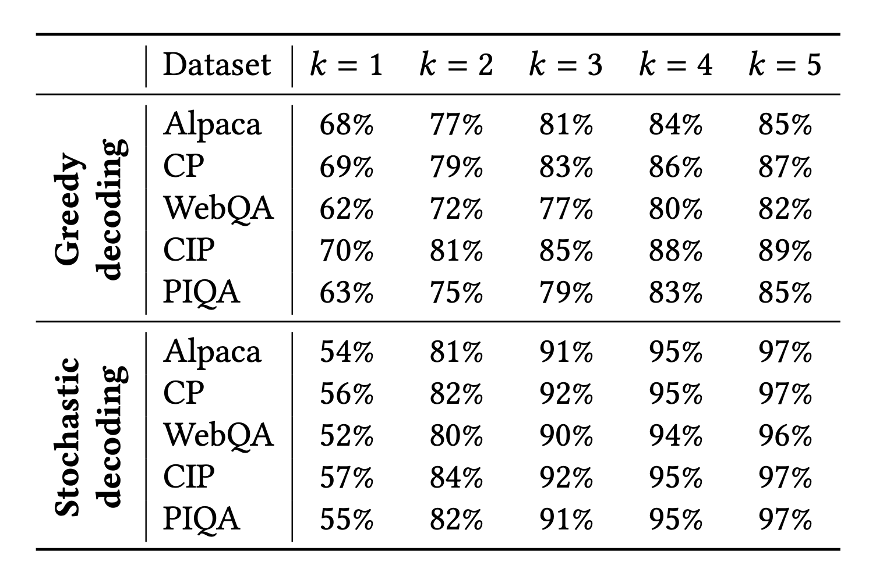
Learning based speculator
Use multiple SSMs to predict token sequences in parallel
Expansion based construction: get multiple tokens from an SSM and pick top K
Merge-based construction: Combine multiple SSMs’ predictions into a tree
Tree structure is static
Benefits: Token match rate, GPU utilization, prediction diversity
Notes:
Learning-Based Speculator’s Role:
The Learning-Based Speculator is central to SpecInfer’s ability to make accurate, speculative predictions. Its job is to create a speculative token tree that aligns as closely as possible with the output of the LLM.
We achieve this by using SSMs, which are smaller, less computationally demanding versions of the LLM.
Speculation Techniques:
The expansion-based method uses a single SSM, generating multiple token predictions at each step. This approach leverages the top-k tokens, increasing our chances of hitting the right sequence.
Merge-based speculation combines outputs from multiple SSMs. This technique uses ensemble learning, aligning more closely with the LLM by merging the most likely tokens from each SSM.
Why It Matters:
The strength of this speculator lies in its scalability and diversity. By generating a range of likely token sequences, it both increases the accuracy of predictions and reduces the need for repetitive LLM processing, which helps with efficiency in real-world applications.
Advantages of the Learning-Based Speculator
High Success Rate: Expanding token options at each step increases the chance of matching LLM output (e.g., accuracy from 57% to 97% for top-5 tokens).
Scalability: Works effectively with multiple SSMs, leveraging GPU resources for faster token generation without significant memory overhead.
Diversity in Predictions: By organizing predictions in a tree, it allows for greater variability, which is especially beneficial in stochastic tasks.

Slide 7
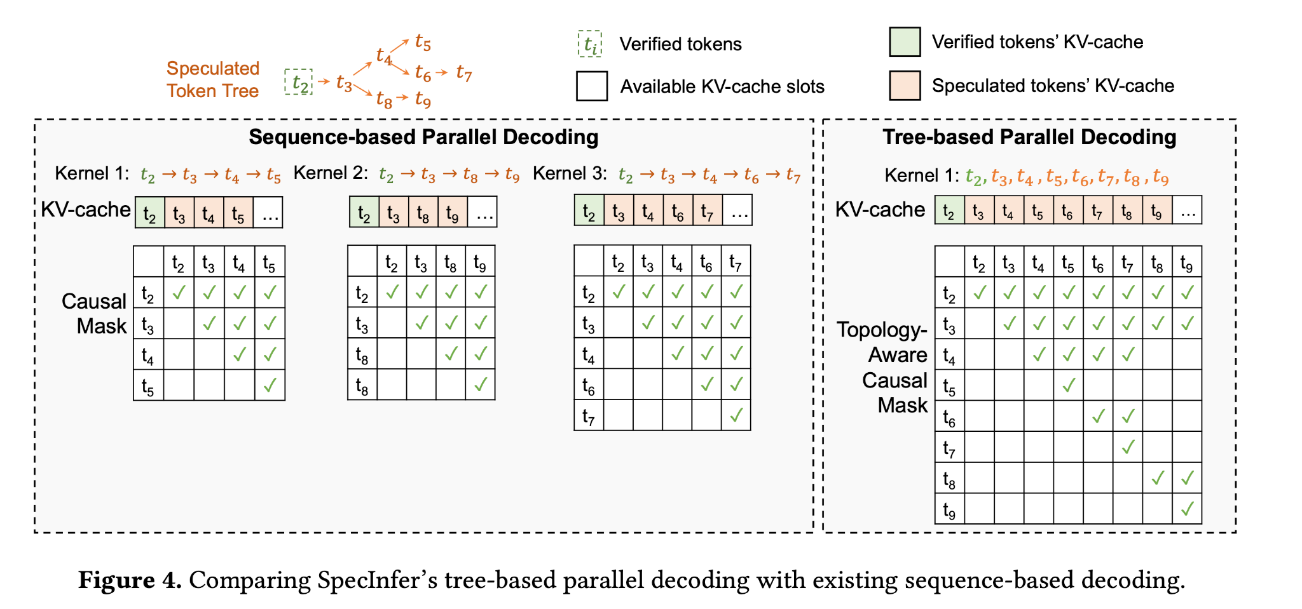
Token verification: How do we efficiently get attention?
Existing solution: verify each sequence, one at a time
SpecInfer: Tree-based parallel decoding:
Flatten the token tree into a sequence
Use masks (“topology aware causal masking”) to keep sequences separate
Prefill
With attention scores, we can compute the probability of each token being the next token.
Notes:
The first step of verifying the speculative tokens is to find their attention scores on the main (large) LLM. To do this, there are 2 ways:
2. Verification Process
Prefill on one sequence at a time:
We can share KV cache for related sequences
Parallelism can be achieved by calling multiple kernels to each verify.
Tree Attention Mechanism:
Extends traditional attention from sequences to tree structures.
Ensures accurate attention calculations by considering all ancestors in the token tree for each token’s context.
4. Benefits of the Token Tree Verifier
Reduced Latency: Verifying multiple tokens in parallel reduces the number of sequential steps required.
Enhanced Accuracy: Maintains generative quality by verifying token paths that align with LLM output tokens.
Scalability: Scales efficiently with large token trees and multiple speculative models.
OLD SPEAKER NOTES:
Purpose of the Token Tree Verifier
Verifies speculative predictions generated by the learning-based speculator against the LLM.
Ensures that only accurate token sequences from the speculative tree are used, preserving the LLM’s output quality.
2. Verification Process
Parallel Decoding:
Verifies all speculative tokens in the tree simultaneously, leveraging GPU parallelism.
Utilizes tree-based parallel decoding, which is more efficient than single-token incremental decoding.
Tree Attention Mechanism:
Extends traditional attention from sequences to tree structures.
Ensures accurate attention calculations by considering all ancestors in the token tree for each token’s context.
3. Greedy and Stochastic Decoding Modes
Greedy Decoding:
Checks if the next token with the highest likelihood matches the LLM output, moving down the tree path.
Stochastic Decoding:
Uses Multi-Step Speculative Sampling (MSS) to match token probability distributions in the tree with the LLM, ensuring equivalence in stochastic outputs.
4. Benefits of the Token Tree Verifier
Reduced Latency: Verifying multiple tokens in parallel reduces the number of sequential steps required.
Enhanced Accuracy: Maintains generative quality by verifying token paths that align with LLM outputs.
Scalability: Scales efficiently with large token trees and multiple speculative models.

Slide 8
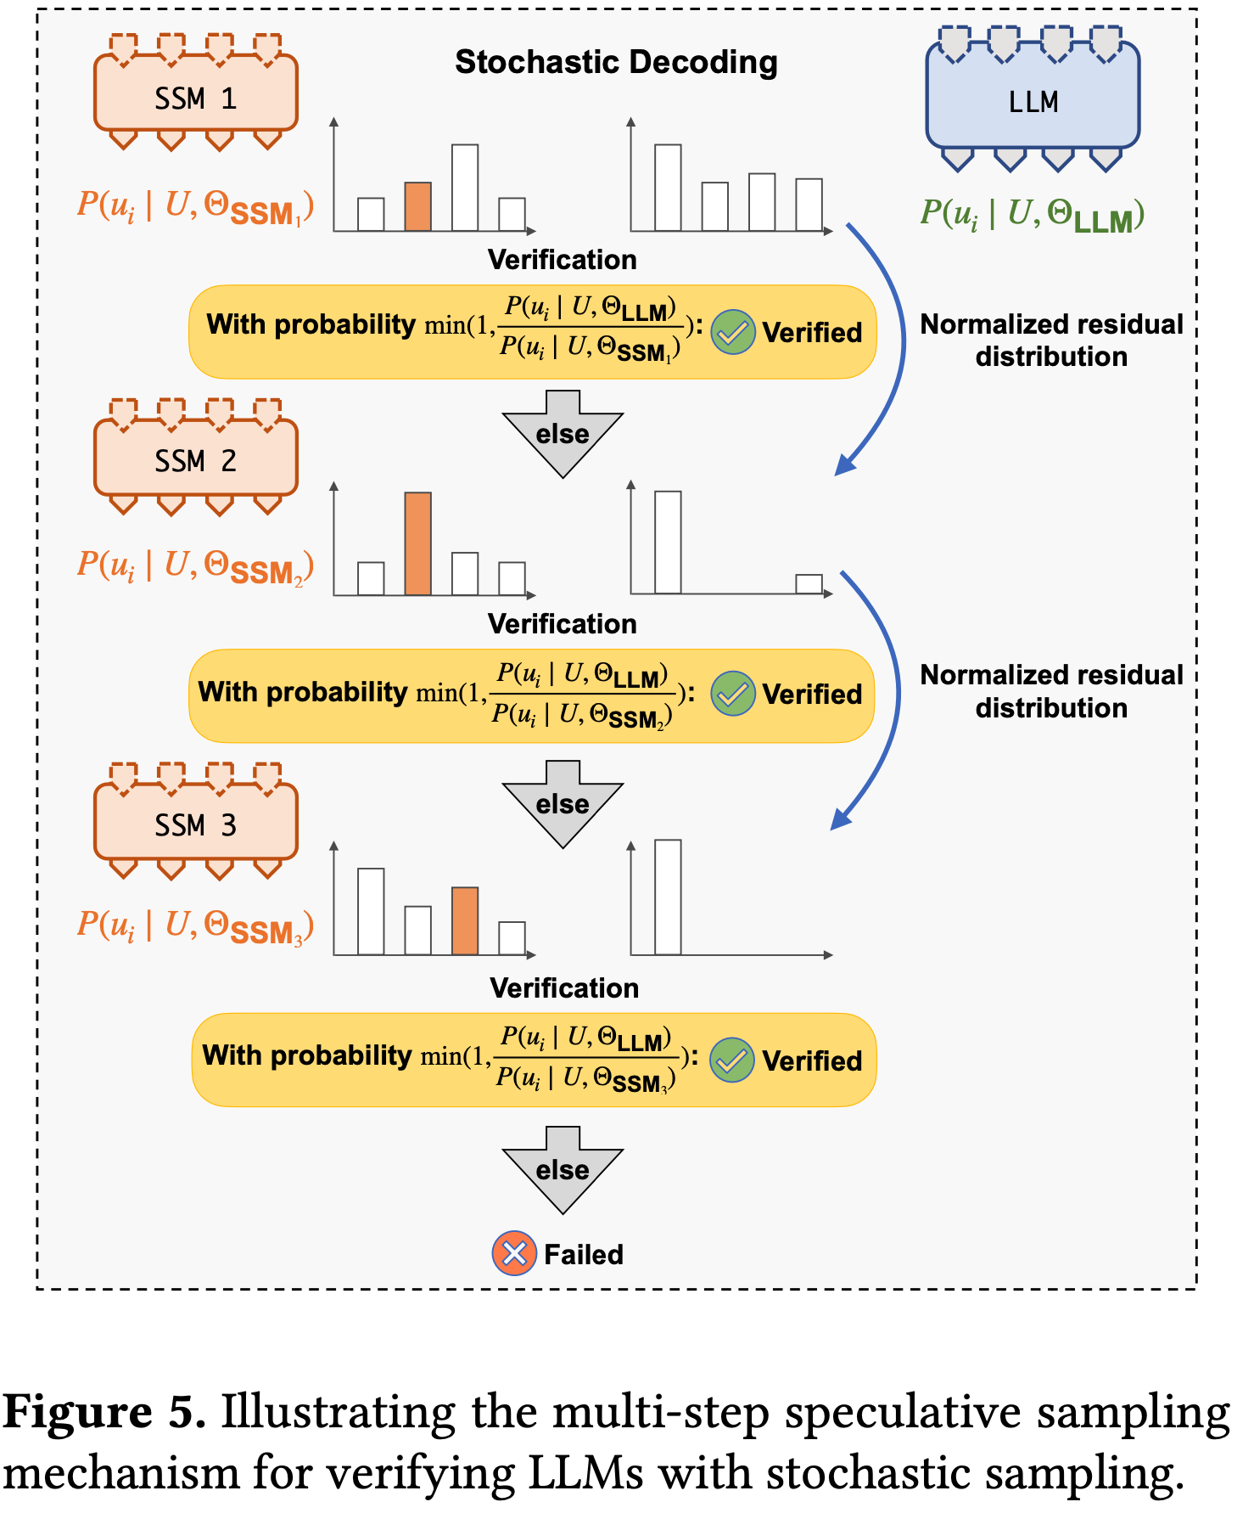
Token verification: How to use attention to get output?
Decoding can use two sampling techniques:
Greedy: Always choose most likely token
Accept token that matches LLM’s most likely token.
Stochastic: Sample from prob. distribution
Verification: Multi-step sampling (MSS).
Select a random child token. For each SSM:
Accept it with probability (P_{LLM}/P_{SSM})
If all SSMs reject, then try another child token.
If no more child tokens, verify next parent token.
Notes:
With the attention scores computed, we can compute the likeliness of each token in the vocabulary at each step. How do we use these probabilities to verify whether a token belongs in the sequence?
Greedy:
Select top 1.
Check if SSM token matches LLM token. If yes, accept it as the true output and verify its children.
Stochastic:
Sample from probability distribution
Criteria for verification: Use the ratio of LLM probability and SSM probability as the probability with which to accept the token. If a token is rejected, we try again with the next SSM until the token is accepted or all SSMs have rejected it.

Slide 9
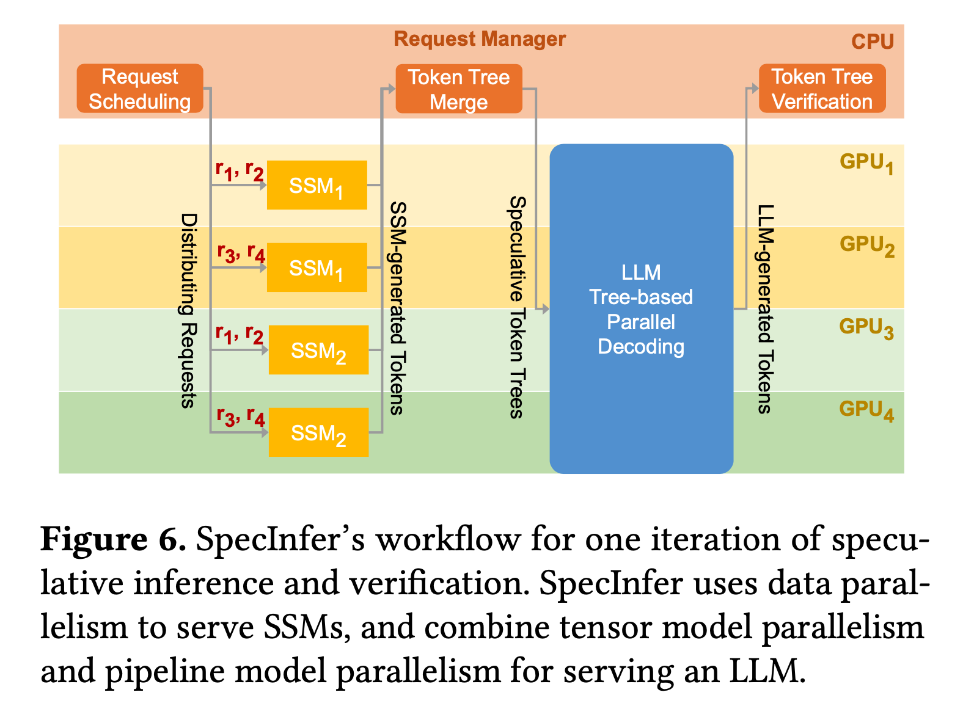
System Design and Implementation
Uses request manager and a set of GPU workers.
Adds a custom CUDA kernel for tree parallel decoding.
Uses continuous batching, model and data parallelism through FlexFlow.
Notes:
1. System Workflow Overview
SpecInfer’s workflow involves a Request Manager and GPU Workers:
Request Manager: Manages incoming requests, organizes them into speculative token trees, and coordinates between SSMs and LLMs.
GPU Workers: Perform parallel decoding and verification tasks, distributing workload across GPUs.
2. Parallelization Strategy
SpecInfer combines Data Parallelism and Model Parallelism:
Data Parallelism: Used for small speculative models (SSMs), allowing each SSM to process predictions on different GPUs.
3D Model Parallelism: Used for large LLMs, leveraging both tensor parallelism (within nodes) and pipeline parallelism (across nodes).
3. Key Optimizations
Continuous Batching and Iteration-level scheduling: Similar to the ORCA paper, it groups multiple requests together and schedules execution on the granularity of iterations, reducing processing delays and allowing faster response to incoming requests.
Customized CUDA Kernels: Optimized kernels reduce memory overhead and computation time for attention operations in tree-based parallel decoding built on top of FasterTransformer.
4. Implementation Framework
Built on FlexFlow (a distributed multi-GPU runtime) for defining and optimizing SpecInfer’s computational graph through a custom compiler to implement the parallelism strategy.
Supports models from PyTorch and HuggingFace, ensuring compatibility and ease of model import.

Slide 10
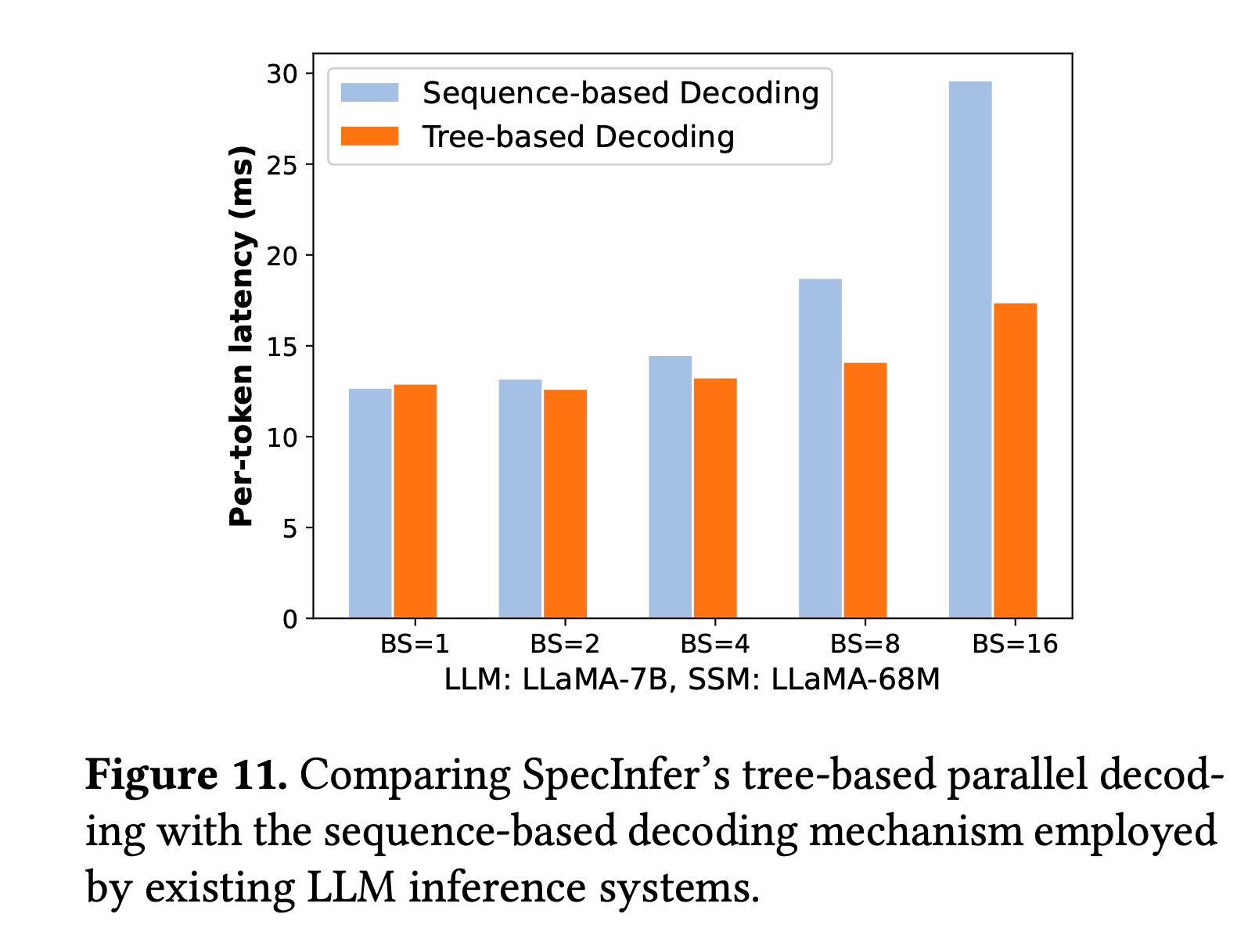
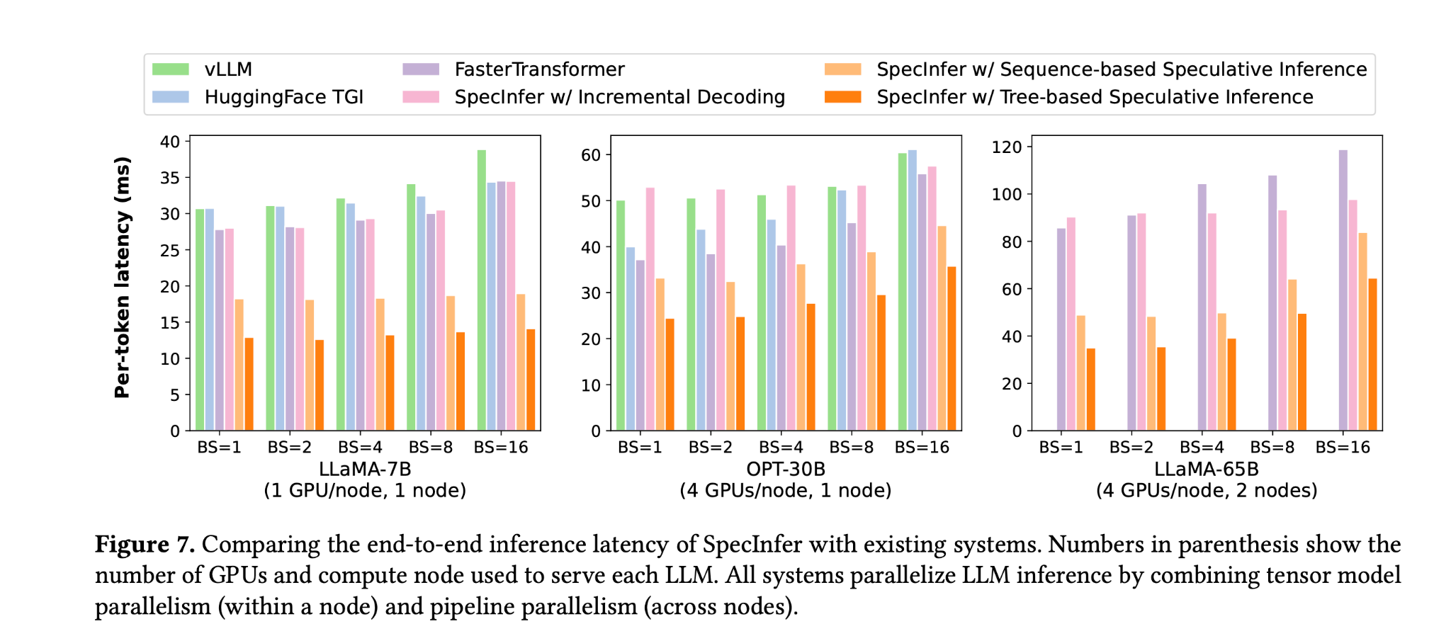
Evaluation
Compared on LLAMA and OPT models for five datasets on GPUs.
Compared against many LLM inference frameworks.
Metrics: inference latency, token throughput, speculative prediction accuracy.
Latency improved ~3X for distributed inference, ~3.5X for offloading inference
Notes:
1. Experimental Setup
Models Used: Tested on large LLMs, including LLaMA-7B, OPT-13B, OPT-30B, and LLaMA-65B.
Datasets: Evaluation conducted using realistic datasets, including Alpaca, WebQA, Chatbot Instruction Prompts (CIP), ChatGPT Prompts (CP), and PIQA.
Platform: Experiments run on AWS g5.12xlarge instances (4x NVIDIA A10 24GB GPUs per node).
2. Performance Metrics
End-to-End Inference Latency: Time taken per token generation across various system setups.
Throughput: Number of tokens processed per second across different batch sizes.
Accuracy of Speculative Predictions: Measured by success rate of verified tokens in token trees.
3. Key Results
Distributed Inference: SpecInfer achieved 1.5-2.8x speedup over existing systems for multi-GPU, distributed LLM inference. The speedup comes from leveraging spare GPU resources to perform tree-based parallel decoding while maintaining the same per-iteration latency as incremental decoding.
Offloading-Based Inference: Improved latency by 2.6-3.5x compared to FlexGen when running large models on a single GPU with parameter offloading. Since offloading-based LLM inference is mostly bottlenecked by the communication between CPU DRAM and GPU HBM for loading an LLM’s parameters, SpecInfer’s improvement over existing systems is achieved by opportunistically verifying multiple tokens, which in turn reduces the number of LLM decoding steps and data transfers between CPU and GPU.
Batch Size Sensitivity: Performance gains are more prominent with smaller batch sizes; larger batch sizes reduce spare GPU resources for speculative decoding but still benefit from lower latency. Overall, SpecInfer is most beneficial for low-latency LLM inference.
4. Summary of Findings
SpecInfer achieves substantial improvements in inference speed and scalability.
Speculative inference and token tree verification effectively reduce end-to-end latency without compromising generative accuracy.

Slide 11
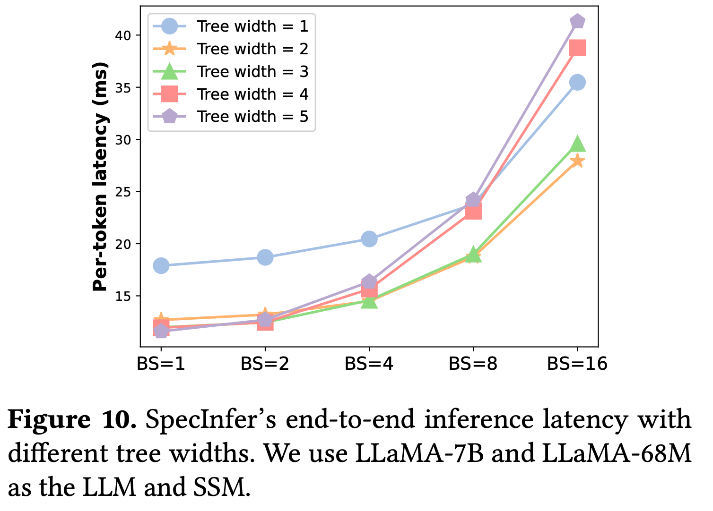
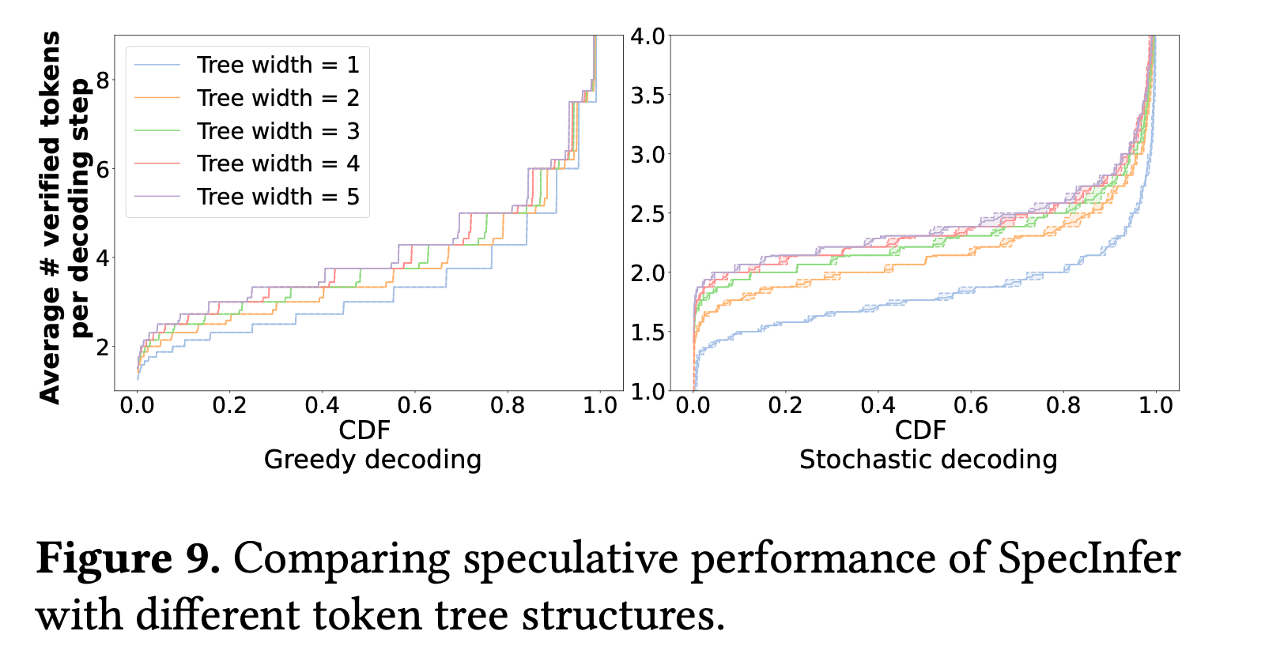
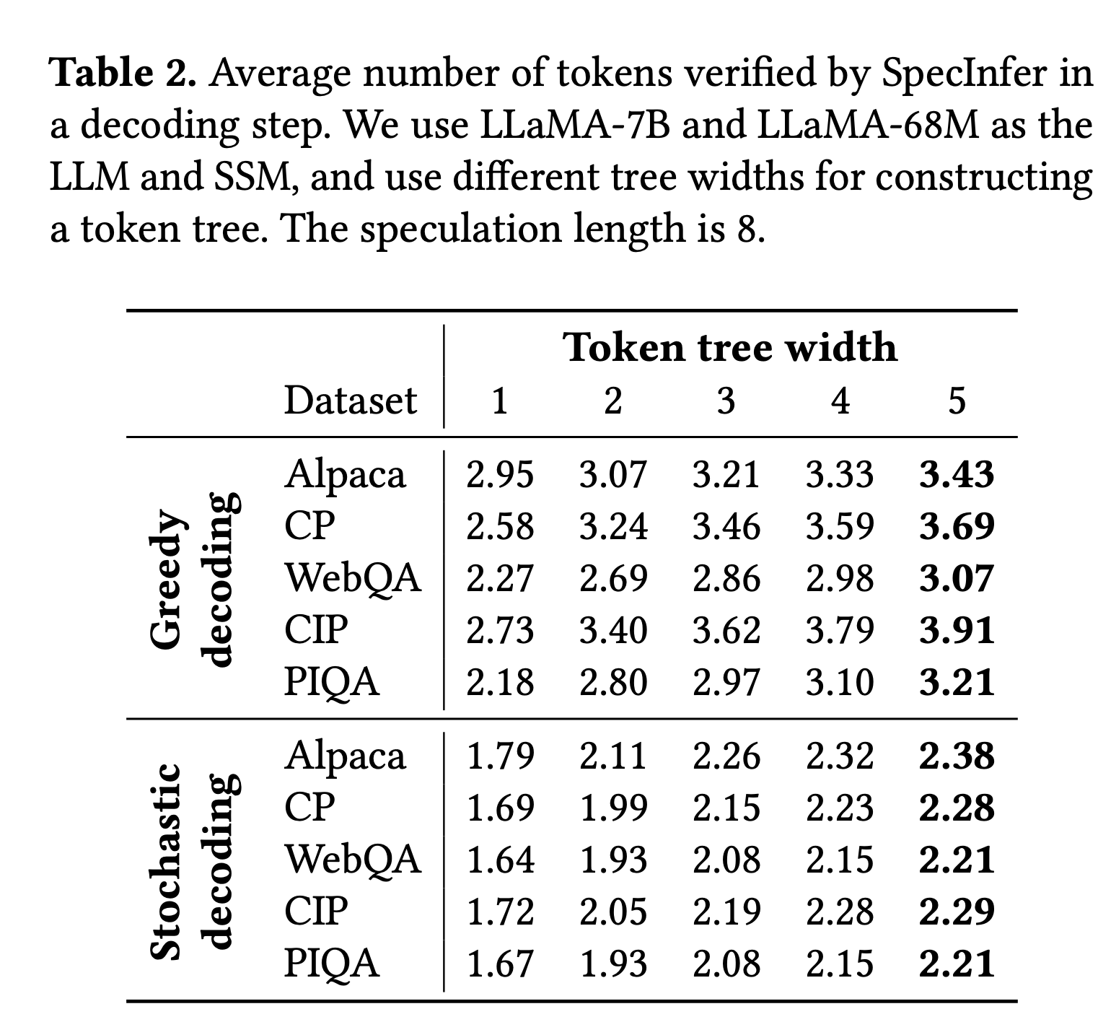
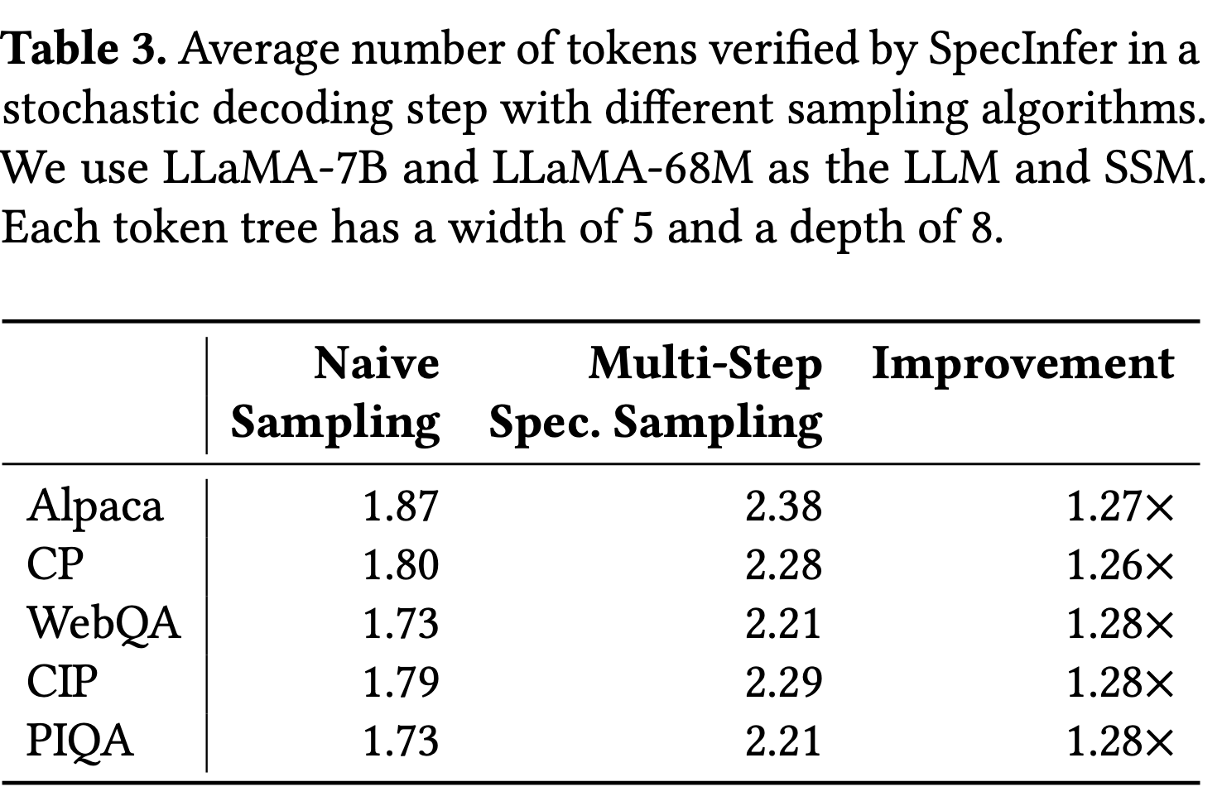
Evaluation part 2
Notes:
Figure 9: Compared to sequence-based speculation (i.e., tree width = 1), leveraging token trees can reduce LLM decoding steps by 1.2-1.5× for greedy decoding and by 1.3-1.4× for stochastic decoding. Token Tree Width: This defines the number of candidate tokens generated at each step of the token tree by each SSM. The width indicates how many tokens are selected as top candidates (e.g., top-1, top-5) from the output of an SSM during speculative inference.
Figure 10: For small batch sizes (i.e., BS = 1 and 2), using a large tree width can consistently reduce per-token latency, since SpecInfer can leverage sparse GPU resources to verify more tokens in parallel while maintaining the same per-iteration latency. For large batch sizes (i.e., BS ≥ 4), using a large tree width increases the latency to verify a token tree due to less sparse GPU resources that can be leveraged by SpecInfer, and a tree width of 2 or 3 achieves the best performance by striking a perfect balance between speculative performance and verification latency.

Slide 12
Strengths and weaknesses
Pro: SpecInfer improves parallelism and GPU utilization and only caches some tokens in its token trees reducing memory pressure.
Con: Memory and Compute Overhead from using multiple SSMs and managing token trees.
Con: SpecInfer’s performance improvement gap reduces as batch size increases.
Con: Static strategy to expand token tree following a preset configuration.
Con: Blanks in the token tree can waste computational resources.
Notes:
Strengths
SpecInfer efficiently handles speculative inference using tree structures, which significantly improves parallelism, GPU utilization, and overall runtime efficiency. Additionally, it optimizes memory usage by caching only some tokens within its token trees, lowering the GPU memory burden.
Weaknesses
Batch size
Note that SpecInfer’s performance improvement over existing systems reduces as the batch size (i.e., number of concurrent requests) increases. This is because SpecInfer leverages spare GPU resources to perform tree-based parallel decoding while maintaining the same per-iteration latency as incremental decoding. A larger batch size introduces more parallelizable computation for incremental decoding, and thus less spare GPU resources that can be leveraged by SpecInfer.
Memory overhead
Memory needs to be allocated for multiple SSMs but due to the smaller size, each SSM increases the memory requirement by around 1%. Typically 2-5 SSM are used for inference to balance the overhead with the benefits.
The token verification engine needs to cache keys and values and attention scores but the paper argues the overhead is small compared to the key-value cache with a long sequence length.
Computational overhead
SpecInfer needs to run each SSM in incremental decoding mode in parallel across GPUs and it needs verify tokens by computing the attention output of the entire token tree. However, the paper argues that the benefit of parallelism negates the runtime overhead.
Expansion-based tree construction
Paper adopts a a static strategy that expands the token tree following a preset expansion configuration and the paper acknowledges that dynamically expanding a token tree from an SSM is an open research problem.
Blanks in token tree
In tree-based speculative inference, blanks (empty tokens or paths that don’t align with the LLM’s actual output) can accumulate as the tree expands. As each token sequence branches, some branches may lead to incorrect or irrelevant predictions, especially with higher tree widths or more speculative models. These unproductive branches increase computational costs without contributing useful output, leading to inefficiencies. Tree attention involves computing attention across all branches in the token tree, including those that may contain blanks. Processing blanks requires attention calculations that consume memory and computation resources but don’t yield valuable results.

Slide 13
PowerInfer
Enabling deployment of LLMs on GPU memory-constrained systems (SOSP 2024)
Yixin Song, Zeyu Mi, Haotong Xie, Haibo Chen
Presented by Michael Wang, Yikang Yue and Nikhil Kanamarla
No squirrels were harmed in the making of this presentation

Slide 14
LLMs are getting large.
Today’s LLMs can easily occupy 100s of GB of memory to store weights.
Meanwhile, the RTX 4090 has:
24GB DRAM
no NVlink
Assuming 16b parameters:
Model | Size (GB)
Llama 3 | 16, 140, 810
OPT | 0.25 - 350
Falcon | 80, 360
PaLM | 1080
GPT4 | 3500

Slide 15
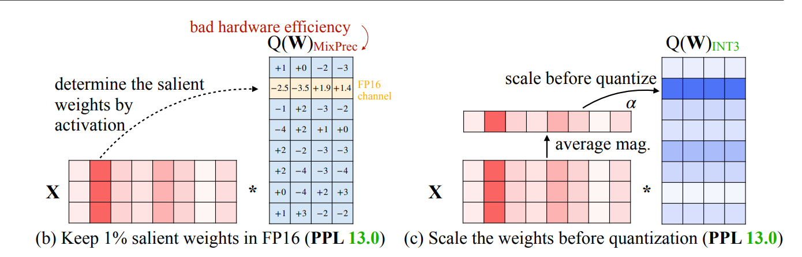
One solution: Make the weights smaller! (Quantization)
AWQ - Activation-aware Weight Quantization (MLSys 2024):
Quantize most weights to 4, 3, or even 2 bit values
Preserve salient weights through higher precision encoding or by scaling.
[1] Heterogeneous Quantization and Activation-aware quantization.
[1] Lin et al. AWQ: Activation-aware Weight Quantization for on-Device LLM compression and acceleration. https://arxiv.org/pdf/2306.00978

Slide 16


But it’s still not enough!
The number of parameters is simply too large to fit on a consumer-grade GPU.
Model | Size (GB)
Llama 3 | 16, 140, 810
OPT | 0.25 - 350
Falcon | 80, 360
PaLM | 1080
GPT4 | 3500
Model | Size (GB)
Llama 3 | 4, 35, 203
OPT | 0.07 - 87.5
Falcon | 20, 90
PaLM | 270
GPT4 | 900

Slide 17


Another solution: Offload some parameters
Put most of the parameters into larger main memory
Put the rest in the GPU memory
How do we handle the computation?

Slide 18
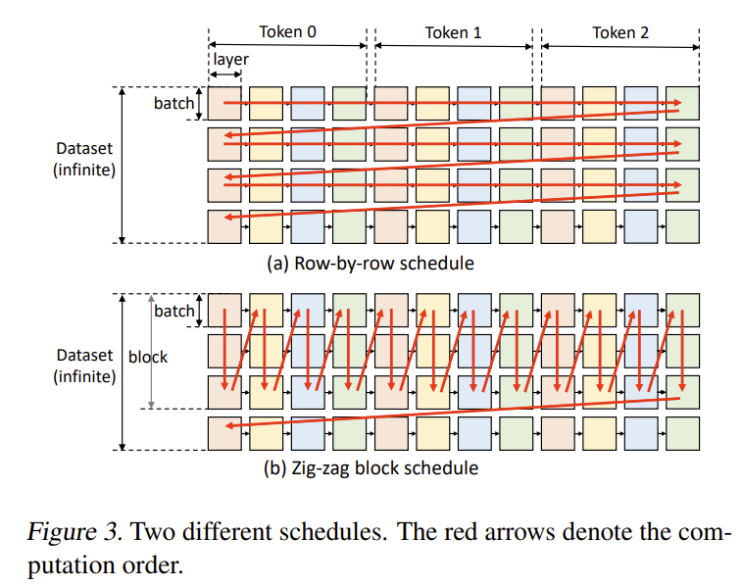
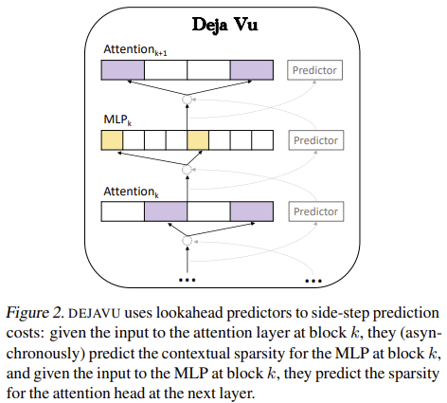
Who uses the parameters?
Existing approaches: GPU.
FlexGen: Perform layer-wise batch processing [1].
DejaVu: Predict activations and move them to GPU [2].
Problem: High latency.
Problem: Frequent data transfer, predictor overhead.
[1] Sheng et al. FlexGen: High-Throughput Generative Inference of Large Language Models with a Single GPU. https://arxiv.org/abs/2303.06865
[2] Liu et al. Deja Vu: Contextual Sparsity for Efficient LLMs at Inference Time. https://arxiv.org/abs/2310.17157

Slide 19
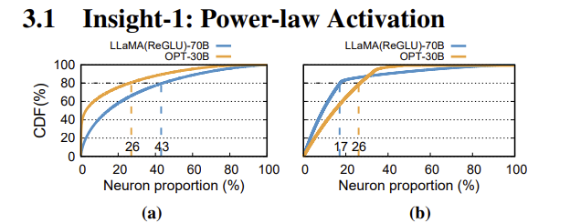
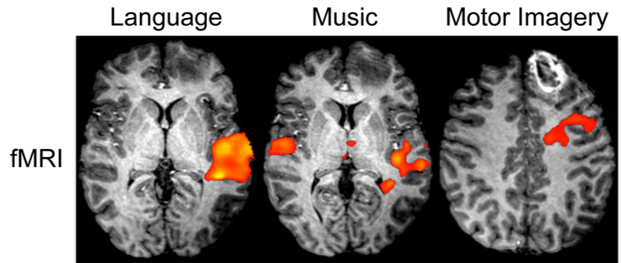
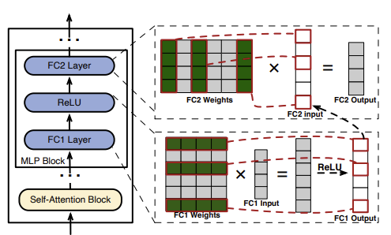
Activation Sparsity
It turns out that for a given input, only some neurons make contributions
~80% are not activated! (OPT-30B)
Activation is nondeterministic
Most activations can be attributed to a few neurons
(~15-25% of neurons account for 80% of activations)
[1]
[1] https://www.comarecoverylab.org/response

Slide 20
PowerInfer: Both devices compute (Hybrid Offloading)
We can reduce data movement (DejaVu) without requiring large batches (FlexGen).
CPU:
Larger, slower memory
Low compute performance (vector extensions help – e.g. AVX2)
GPU:
Small, higher bandwidth memory
High compute performance
Cold neurons:
Many
Rarely impactful
Hot neurons:
Few
Frequently used

Slide 21
PowerInfer: Two challenges
How to determine hot and cold neurons?
How to enable accurate predictors while maintaining small predictor footprint?

Slide 22
How do we find hot and cold neurons?
Offline Profiling.
Run model on a representative dataset
Gather activation data
Find impact of each neuron
Neuron impact = Activation frequency
Use ILP solver to determine which neurons should go to GPU.

Slide 23
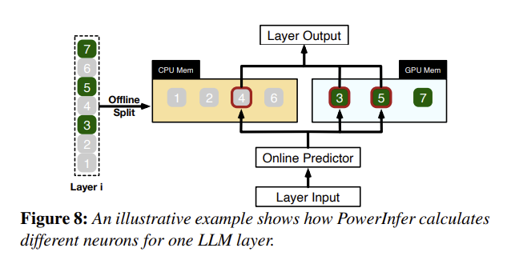
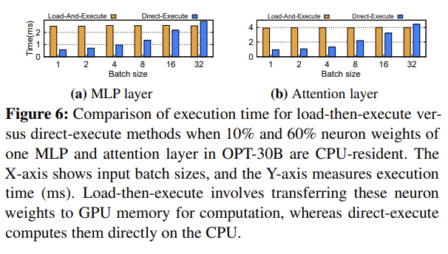
How does this inform neuron placement?
Placement: Maximize impactful neurons on GPU
Two constraints:
Communication/Sync. Overhead
Make sure GPU has enough work to make communication worth it.
Memory capacity
Use ILP solver to find near-optimal solution
Neurons are grouped into batches to reduce solving time

Slide 24
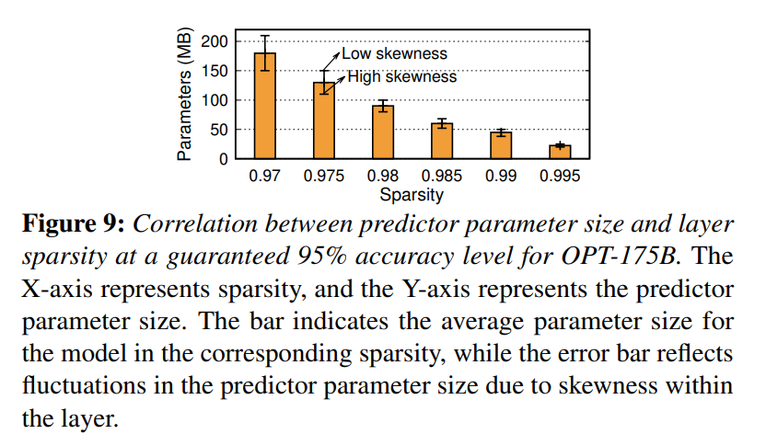
PowerInfer: Which neurons to compute?
To exploit sparsity, we should compute only the important neuron activations.
How do we know which activations are important?
Online DL predictors. (Neuron-aware LLM Inference Engine)
Challenge: Accurate predictors require lots of space.
DejaVu: Homogeneous layerwise predictors for OPT-175B: 27GB

Slide 25
PowerInfer: Which neurons to compute?
Solution: Adjust each layer’s predictor based on:
Sparsity: How many neurons don’t contribute?
Skewness: How concentrated are activations?
Result: PowerInfer “...limits predictor parameters to a mere 10% of the total LLM parameters.”

Slide 26
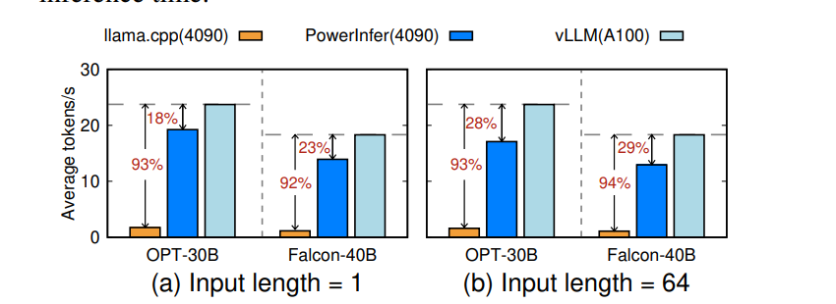
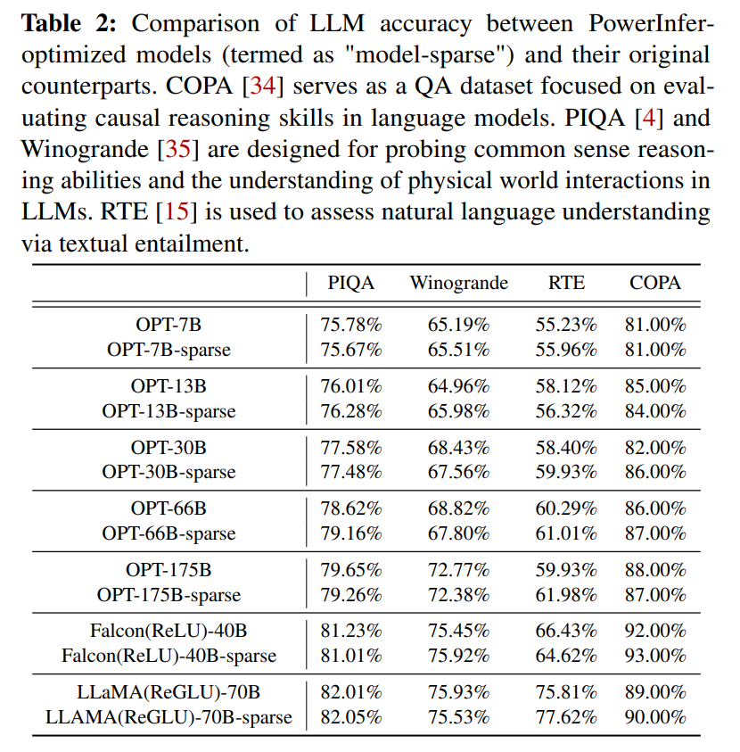
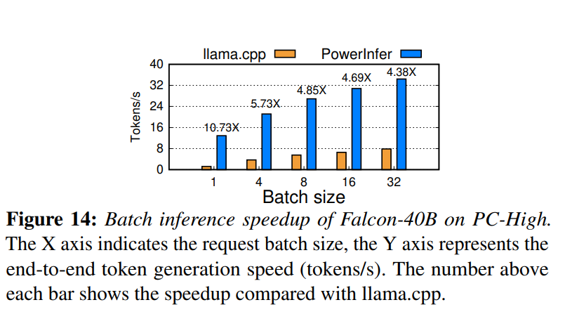
Results
Between ~5-10x speedup vs. llama.cpp depending on batch size.
Approaches performance of A100 running vLLM.
Negligible accuracy loss
Works with quantization

Slide 27
Limitations
Activation predictors may further decrease model explainability
Applicability depends on activation function
Depends on accurate profiling
Model accuracy is affected – even if only slightly
Requires special operators to support low-overhead, dynamic sparse inference (programmability issue)
Incompatible with existing sparse matrix multiplication tools
The authors had to write 10 neuron-aware operators
Comparison to A100
Benchmark model parameters (30B and 40B) leave little room for KV cache on A100
Weird choice of input sequence lengths

Slide 28
Thanks! Questions?

